Slide 1
ELECTROCHEMICAL REDUCTION OF CARBON DIOXIDE
SWAPNIL GANGRADE
210122060
13TH OCTOBER , 2023

Slide 2
OUTLINE TO THE PRESENTATION
INTRODUCTION
a) WHY DO WE NEED THIS
b) PROPOSED MECHANISMS
2. WHAT IS ELECTROCHEMICAL REDUCTION
3. PROPERTIES OF CARBON DIOXIDE
4. MECHANISMS OF CO₂ REDUCTION
a) Metallothermic reactions
b) Electrochemical reactions
ELECTRO-REDUCTION OF CO₂ TO SOLID CARBON
SOLID OXIDE ELECTROLYSIS CELLS (SOECs)
HYBRID ELECTRO-THERMOCHEMICAL LOOPING
ECONOMICAL ANALYSIS WITH GRAPHITE AS AN EXAMPLE
CHALLENGES FACED
CONCLUSIONS
REFERENCES

Slide 3
INTRODUCTION

Slide 4
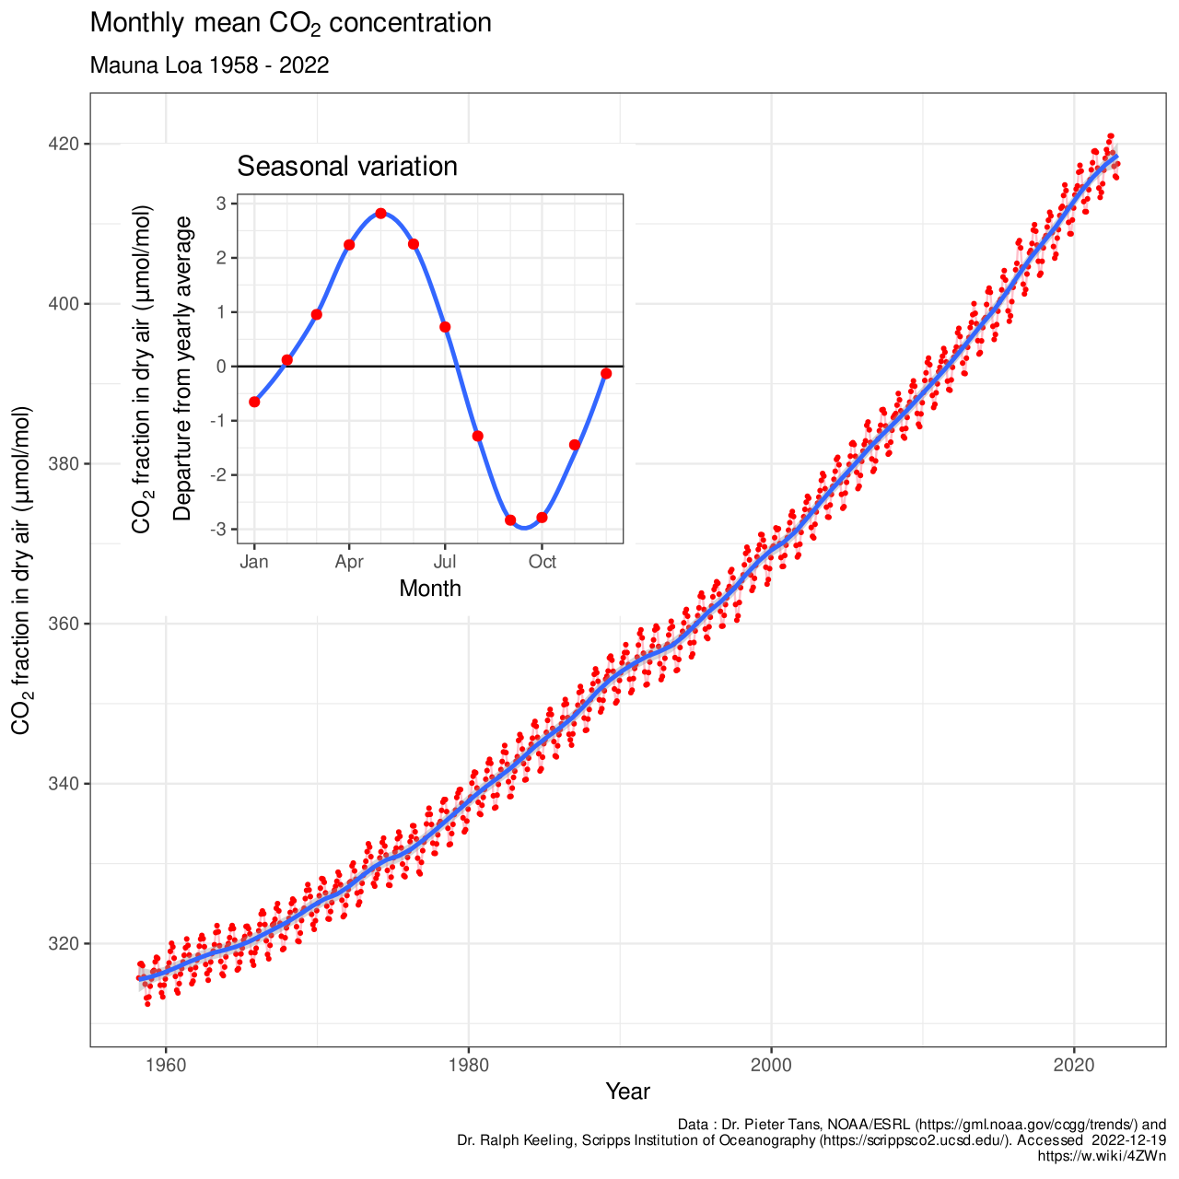
INTRODUCTION
WHY DO WE NEED THIS ?
Increased usage of Fossil Fuels over the decades has resulted in higher carbon dioxide percentage in Atmospheric air. Therefore, electrochemical reduction provides a potential solution in reduction of this percentage, because the reaction is controllable and it is eco-friendly.
It is estimated that by 2050, the energy consumption is will reach 27 TW. Fossil Fuels, being the main energy source, release huge amount of Carbon Dioxide into Atmosphere on consumption.
Since 1860, the average annual growth rate of carbon dioxide emissions from fossil fuel combustion has been 4.22%.

Slide 5
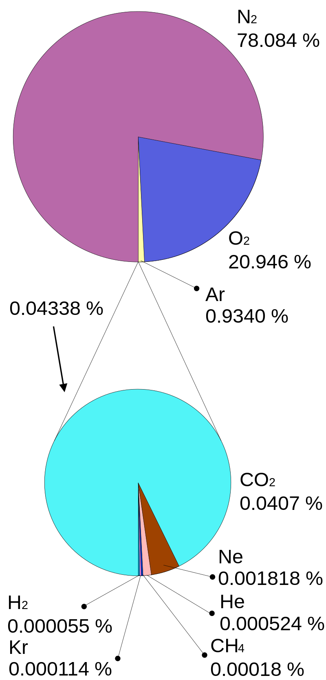
INTRODUCTION
WHY DO WE NEED THIS ?
Increased usage of Fossil Fuels over the decades has resulted in higher carbon dioxide percentage in Atmospheric air. Therefore, electrochemical reduction provides a potential solution in reduction of this percentage, because the reaction is controllable and it is eco-friendly.
It is estimated that by 2050, the energy consumption is will reach 27 TW. Fossil Fuels, being the main energy source, release huge amount of Carbon Dioxide into Atmosphere on consumption.
Since 1860, the average annual growth rate of carbon dioxide emissions from fossil fuel combustion has been 4.22%.

Slide 6
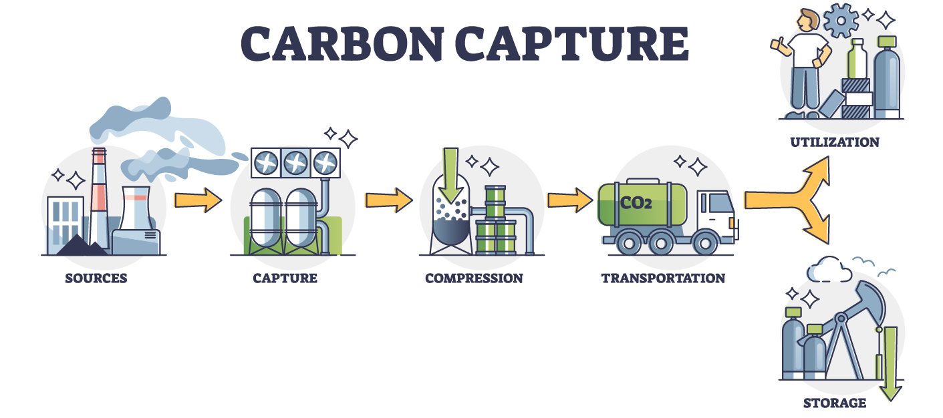
INTRODUCTION
PROPOSED SCHEMES FOR CO₂ REDUCTION IN ATMOSPHERE
CARBON CAPTURE AND STORAGE ( CCS ) : There are four capture methods for carbon dioxide: chemical absorption, physical adsorption, membrane separation, and cryogenic distillation.
CARBON CAPTURE AND UTILISATION ( CCU ) : Carbon capture and utilisation refers to a range of applications through which CO₂ is captured and used either directly (i.e. not chemically altered) or indirectly (i.e. transformed) in various products. CO₂ is today primarily used in the fertiliser industry and for enhanced oil recovery.
At present, the research on carbon dioxide reduction mainly focuses on electro-chemical, photocatalytic, and thermochemical reduction processes.
Electrochemical reduction is considered as one of the most attractive methods because of its simplicity, low environmental requirements & easiness to scale up.
Notes:
There are four capture methods for carbon dioxide: chemical absorption, physical adsorption, membrane separation, and cryogenic distillation. Many methods have been proposed and attempted or applied for carbon dioxide storage, including capturing carbon dioxide and using high-pressure water to inject carbon dioxide and seal it in abandoned oil or gas fields or convert it into dry ice and bury it deep in the seabed.

Slide 7
OUTLINE TO THE PRESENTATION
INTRODUCTION
a) WHY DO WE NEED THIS
b) PROPOSED MECHANISMS
2. WHAT IS ELECTROCHEMICAL REDUCTION
3. PROPERTIES OF CARBON DIOXIDE
4. MECHANISMS OF CO₂ REDUCTION
a) Metallothermic reactions
b) Electrochemical reactions
ELECTRO-REDUCTION OF CO₂ TO SOLID CARBON
SOLID OXIDE ELECTROLYSIS CELLS (SOECs)
HYBRID ELECTRO-THERMOCHEMICAL LOOPING
ECONOMICAL ANALYSIS WITH GRAPHITE AS AN EXAMPLE
CHALLENGES FACED
CONCLUSIONS
REFERENCES

Slide 8
PROPERTIES OF CARBON DIOXIDE

Slide 9
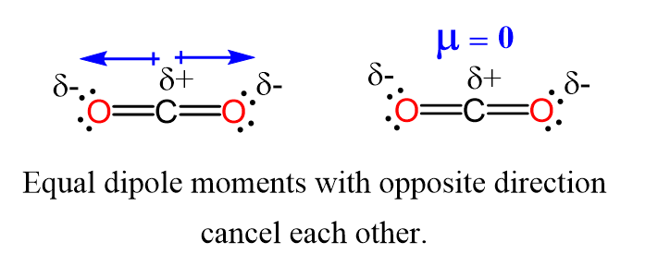
PROPERTIES OF CARBON DIOXIDE
Carbon Dioxide is a colorless gas. At lower concentrations, it has no odor, but in higher concentrations, it has a peculiar acidic smell. At STP, it has a density of 1.98 kg/m³.
Its molecular structure is linear because of sp-hybridized atomic orbitals with no dipole moment.
In gaseous state it is highly soluble in water, which is helpful in its electrochemical reduction.
Bond enthalpy of Carbon-Oxygen double bond is nearly 532 kJ/mol.
Standard enthalpy of formation is around -393.5 kJ/mol .
Standard molar entropy is 214.0 J mol⁻¹ K⁻¹ .

Slide 10
MECHANISMS FOR CO₂ REDUCTION
Several techniques have been investigated by the researchers for the direct conversion of Carbon Dioxide into solid Carbon materials. Our main concern narrows down to the following Two approaches :-
Metallothermic Reactions
Electrochemical Reactions
Notes:
Metallothermic reduction is a process where a metal is used as a reducing agent to obtain a specific metal or compound from source materials like oxides or halides.

Slide 11
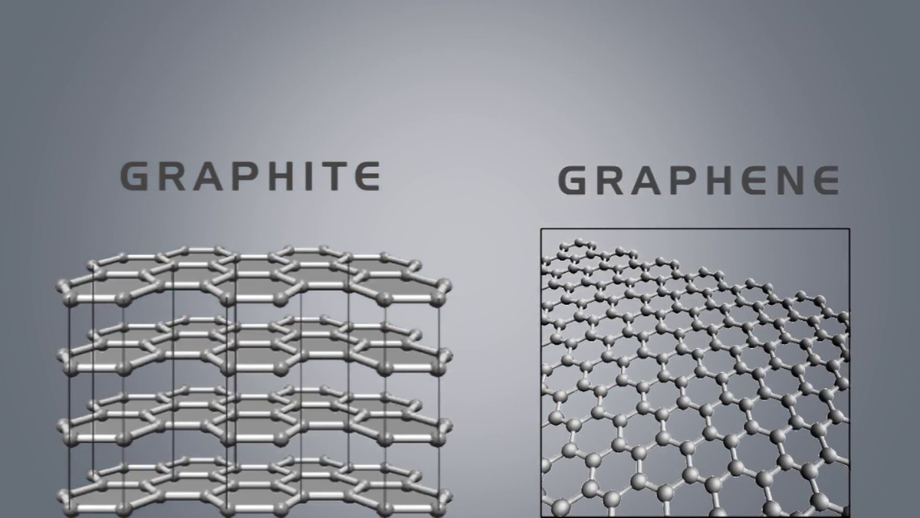
MECHANISMS FOR CO₂ REDUCTION
1. Metallothermic Reactions
Previously, researchers have transformed carbon dioxide into Carbon spheres, Graphene, Graphite and Carbon nanotubes.
MATERIAL | KEY PROPERTIES | PRACTICAL USES
Carbon Spheres | Energy Storage and Conversion | Electrodes in Super-capacitors & Lithium-ion batteries
Graphene | Thermal and electrical conductivity, Elasticity and Flexibility | Heat sink for electronic chips,
Carbon Nanotubes | Highly Flexible, High thermal & Electrical conductivity | Thin-film electronics, electromagnetic shields

Slide 12
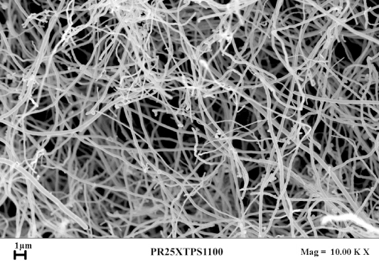
PRODUCTS OF CO₂ REDUCTION WITH ADDED VALUES
Carbon Nanotubes : Abbreviated as CNTs, these are an allotropic form of carbon with a diameter in nanoscale (0.5-2.0 nm) range. These are majorly of two types : single walled and multi walled.
Carbon Nanofibers : (CNFs) are cylindrical nanostructures with graphene layers arranged as stacked cones, cups or plates. Carbon nanofibers with graphene layers wrapped into perfect cylinders are called CNTs.
Notes:
Single walled CNT is shaped like regular hexagonal lattice drawn on an infinite cylindrical surface, whose vertices are the positions of the carbon atoms. Multi walled CNT are tube-in-tube structures of single walled CNTs.

Slide 13
MECHANISMS FOR CO₂ REDUCTION
Metallothermic Reactions
But this mechanism has a few drawbacks :
Complex Operational Techniques.
Use of Expensive Reductants like Lithium, Sodium, Magnesium & Calcium.
Reductants such as Ferrocene cause Environmental pollution.

Slide 14
MECHANISMS FOR CO₂ REDUCTION
Because of all these Drawbacks, researchers have shifted there focus to Electrochemical approaches for reducing carbon dioxide to solid carbon material.
Electrochemical approaches are better because :
Simple Operational method
Improvised control over the Reaction
Environment Friendly – Zero or Negative Carbon Footprint

Slide 15
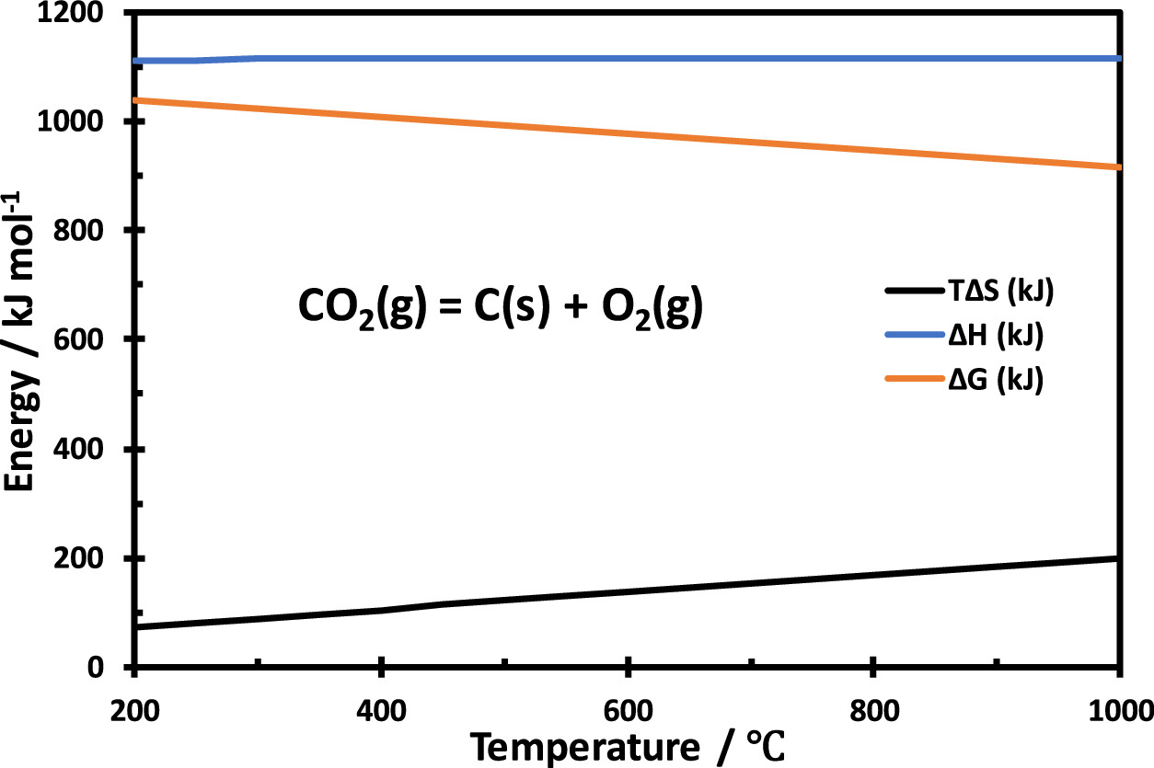
MECHANISMS FOR CO₂ REDUCTION
2. Electrochemical Reactions
THERMODYNAMICAL ASPECT

Slide 16
MECHANISMS FOR CO₂ REDUCTION
2. Electrochemical Reactions
CHALLENGES IN CO₂ ELECTROLYSIS
Strong Carbon-Oxygen Double bonds in CO₂ and low energy level associated CO₂.
Interference of deposited Carbon (on the catalyst material due to Coking) in the process.
Difficulty in converting Carbon dioxide from gas to solid phase.

Slide 17
OUTLINE TO THE PRESENTATION
INTRODUCTION
a) WHY DO WE NEED THIS
b) PROPOSED MECHANISMS
2. WHAT IS ELECTROCHEMICAL REDUCTION
3. PROPERTIES OF CARBON DIOXIDE
4. MECHANISMS OF CO₂ REDUCTION
a) Metallothermic reactions
b) Electrochemical reactions
ELECTRO-REDUCTION OF CO₂ TO SOLID CARBON
SOLID OXIDE ELECTROLYSIS CELLS (SOECs)
HYBRID ELECTRO-THERMOCHEMICAL LOOPING
ECONOMICAL ANALYSIS WITH GRAPHITE AS AN EXAMPLE
CHALLENGES FACED
CONCLUSIONS
REFERENCES

Slide 18
ELECTRO-REDUCTION OF CO₂ TO SOLID CARBON
Solid Oxide Electrolysis Cells (SOECs) for converting CO₂ to solid Carbon |  | The Hybrid Electrothermal looping strategy
This presentation shows Two approaches by which we can overcome the challenges discussed.

Slide 19
1. Solid Oxide Electrolysis Cells (SOECs) for converting CO₂ to solid Carbon
For Carbon dioxide electrolysis in SOECs, the reaction at the Cathode is :
CO₂ + 2e⁻ → CO + O²⁻
O + 2e⁻ → C + O²⁻
The production and deposition of carbon materials often lead to their adherence and buildup on the catalyst material's surface. This is referred to as coking.
Coking diminishes the number of active sites accessible for catalytic reactions, resulting in a decrease in the overall catalytic efficiency and performance.
The rection taking place at Anode is :
2O²⁻ → O₂ + 4e⁻

Slide 20
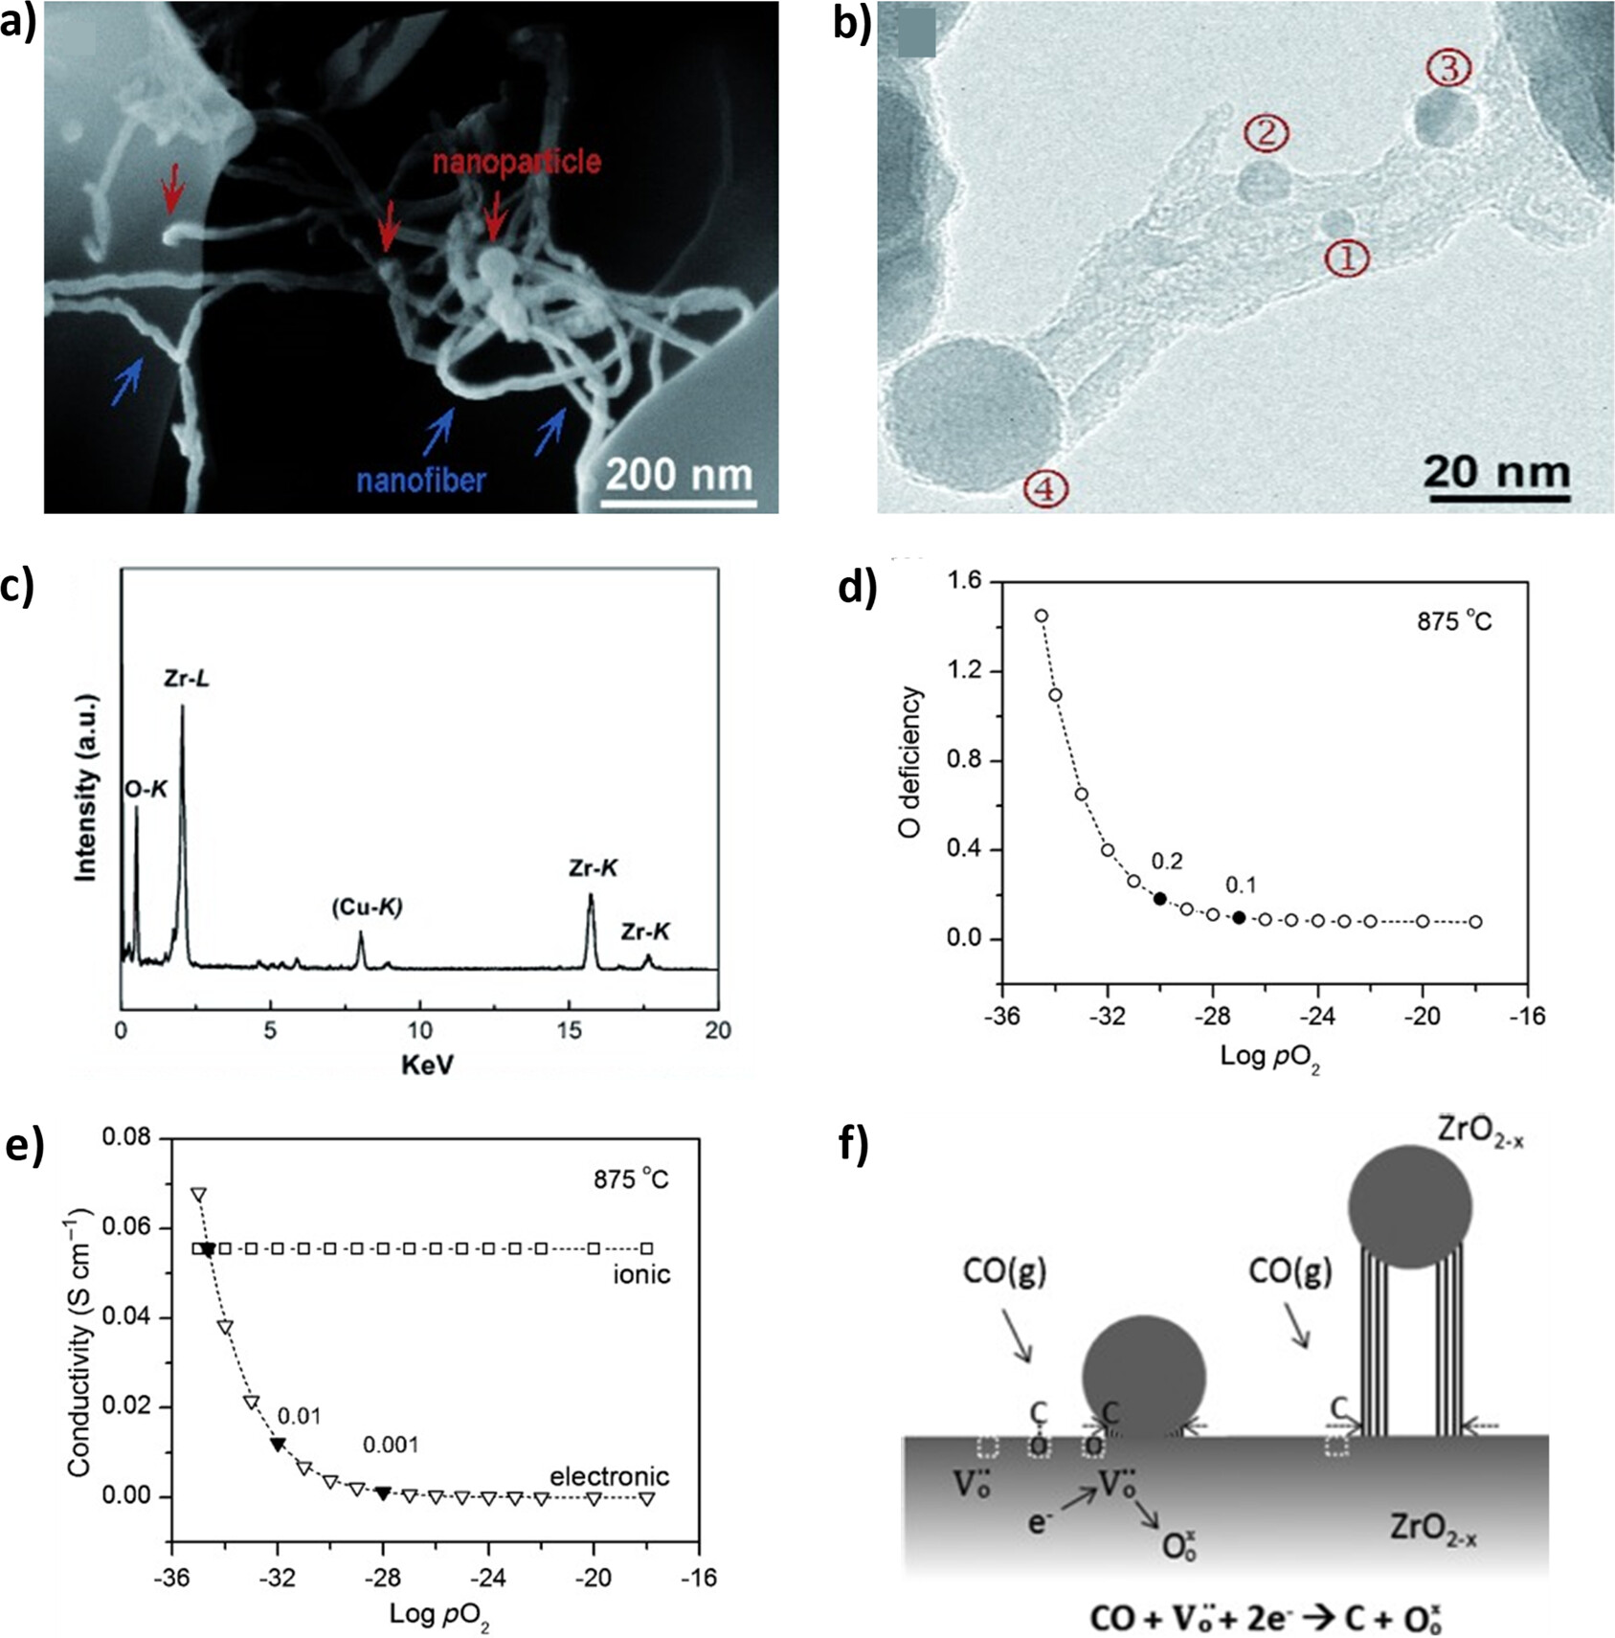
1. Solid Oxide Electrolysis Cells (SOECs) for converting CO₂ to solid Carbon
Formation of Carbon Nanotubes on SOECs :
Anode : Lanthanum Strontium Manganite (LSM) – YSZ
Cathode : Ni - YSZ
Electrolyte : Yttria Stabilised Zirconia (YSZ)
Input current Density : 2.25 A cm⁻²
Temperature : 875 deg. Celsius.

Slide 21
1. Solid Oxide Electrolysis Cells (SOECs) for converting CO₂ to solid Carbon
Formation of Carbon Nanotubes on SOECs :
Anode : Lanthanum Strontium Manganite (LSM) – YSZ
Cathode : Ni - YSZ
Electrolyte : Yttria Stabilised Zirconia (YSZ)
Input current Density : 2.25 A cm⁻²
Temperature : 875 deg. Celsius.

Slide 22
HYBRID ELECTRO-THERMOCHEMICAL LOOPING

Slide 23
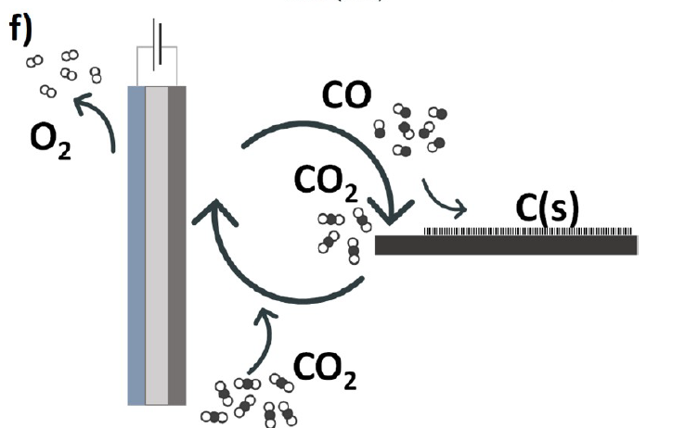
Hybrid electro-thermochemical looping
It follows a two-step mechanism with the first step as reduction of CO₂ into CO and Oxygen at high temperature SOEC. The second step is the Boudouard reaction where Carbon Monoxide goes disproportionation reaction at higher temperatures.
Step 1 : CO₂(g) → CO(g) + ½ O₂(g)
Step 2 : CO(g) → C(s) + ½ O₂(g) (disproportionation reaction)
Enthalpy change for the second step in the mechanism is (-172) kJ/mol.
The resulting carbon deposits consist of amorphous carbon, graphite, and carbon nanotubes.
Instead of direct conversion to solid carbon, conversion Carbon monoxide necessitates relatively moderate reaction conditions

Slide 24
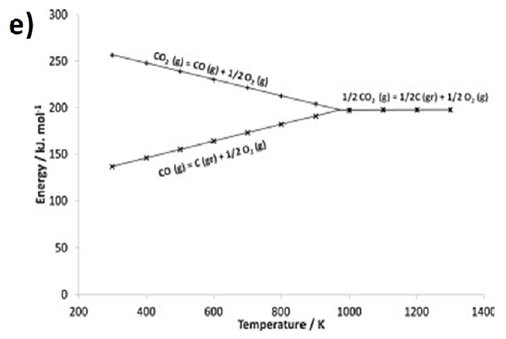
Hybrid electro-thermochemical looping
By comparison of the Gibbs free energy, as shown in below graph, it is observed that the production of solid carbon becomes the predominant reaction only when the temperature exceeds 971 K in the electrolytic system.
In the Boudouard reaction, at higher temperatures exceeding 700 °C, the positive entropy contribution becomes dominant, leading to a spontaneous shift of the reaction equilibrium toward the formation of CO.
High-temperature conditions are unfavourable for the production of solid carbon.

Slide 25
OUTLINE TO THE PRESENTATION
INTRODUCTION
a) WHY DO WE NEED THIS
b) PROPOSED MECHANISMS
2. WHAT IS ELECTROCHEMICAL REDUCTION
3. PROPERTIES OF CARBON DIOXIDE
4. MECHANISMS OF CO₂ REDUCTION
a) Metallothermic reactions
b) Electrochemical reactions
ELECTRO-REDUCTION OF CO₂ TO SOLID CARBON
SOLID OXIDE ELECTROLYSIS CELLS (SOECs)
HYBRID ELECTRO-THERMOCHEMICAL LOOPING
ECONOMICAL ANALYSIS WITH GRAPHITE AS AN EXAMPLE
CHALLENGES FACED
CONCLUSIONS
REFERENCES

Slide 26
ECONOMICAL ANALYSIS WITH GRAPHITE AS AN EXAMPLE
Graphite plays a crucial role in storing and releasing electrical energy in batteries. With the increasing shift towards electric vehicles (EVs) and hybrid electric vehicles (HEVs), the demand for graphite is expected to grow significantly.
Natural graphite is less expensive, the price for natural flake graphite used in batteries is approximately $1500 per metric ton.
However, when this graphite is further processed into coated spherical purified graphite (CSPG) for high-power lithium battery electrodes, it reaches a selling price of up to $20,000 per metric ton.
Notes:
Global demand for graphite is projected to reach 1.9 million tons by 2028, and the battery-grade graphite market is set to be worth around $14 billion by 2025.

Slide 27
CHALLENGES FACED
SOLID OXIDE ELECTROLYSIS CELLS (SOECs) | HYBRID ELECTRO-THERMOCHEMICAL LOOPING
generation of carbon nanotubes occurs within the porous electrode near the SOEC electrolyte−electrode interface, posing challenges for the recovery of the target product. | the selectivity of the catalyst is challenged by potential competing reactions, such as hydrogen evolution.
the growth of carbon nanotubes leads to the lifting of zirconia nanoparticles from the electrode surface, resulting in the sacrificial loss of catalysts. | purification and separation of carbon monoxide generated in the first step for transportation to the second-step reactor
the performance of SOEC is expected to degrade over time, potentially leading to electrode cracking and other issues. | separation and recycling of carbon dioxide generated in the Boudouard reaction of the second-step reactor back to the first-step reactor

Slide 28
Conclusion

Slide 29
References
https://pubs.acs.org/doi/10.1021/acs.energyfuels.3c02204?ref=pdf
https://en.wikipedia.org/wiki/Carbon_dioxide
https://en.wikipedia.org/wiki/Carbon_dioxide_in_Earth%27s_atmosphere
https://en.wikipedia.org/wiki/Atmosphere_of_Earth#Composition
https://en.wikipedia.org/wiki/Carbon_nanotube
https://en.wikipedia.org/wiki/Carbon_nanofiber

Slide 30
Questions & answers
Invite questions from the audience

